Slide 1
Mineral resources

Slide 2
Facts about Mineral resources
The first metals to be unearthed were gold and copper.
Individual Americans use an average of 40,000 pounds of minerals each year.
Petroleum is used in more than 6,000 daily items.
The ‘Luck of the Irish’ is an old mining term.
The average modern electronic device has more than 35 minerals in it.
You can’t grow it, it has to be mined or recycled

Slide 3
What are minerals?
“A mineral is a naturally occurring substance, representable by a chemical formula, that is usually solid and inorganic, and has a crystal structure”.
Mineral resources are the key material basis for socio-economic development.
Statistical results show that more than 95% of energy used by mankind, 80% industrial raw materials and 70% raw materials for agricultural production are from mineral resources.
Minerals are non renewable resource.
According to international Mineralogical association:
Mineral should be natural in origin and formed by natural geological process.
It must be in solid state.
It must have well defined crystallographic structure.
It must have a fairly well defined chemical composition.

Slide 4
Evolution of mineral resources in Indian context
In 1960, many minerals resources have been explored in India.
Geological Survey of India investigates and assess coal and other mineral resources of the country with regional level exploration.
Inferred mineral resources: It is the part of a mineral resource for which quantity, grade and mineral content can be estimated with a low level of confidence. It is based on information gathered through appropriate techniques. The maximum error limit and quality of estimated reserve was 50%.
Indicated resources: are simply economic mineral occurrences that have been sampled (from locations such as outcrops, trenches, pits and drill holes) to a point where an estimate has been made, at a reasonable level of confidence, of their contained metal, grade, tonnage, shape, densities, physical characteristics. The maximum error limit in quality was 30%.

Slide 5
Measured resources: are indicated resources that have undergone enough further sampling that a 'competent person' (defined by the norms of the relevant mining code; usually a geologist has declared them to be an acceptable estimate, at a high degree of confidence, of the grade (or quality), quantity, shape, densities, physical characteristics of the mineral occurrence. The maximum error limit in quantity of estimated reserves was 15% .
Developed Resources: This is the blocked out quantity for mining.

Slide 6
Distribution of Mineral resources in India
Explorations have found over 20,000 known mineral deposits and recoverable reserves of more than 60 minerals.
11 states account for 90 % of the total number of operational mines (Andhra Pradesh, Orrisa, Chhattisgarh, Jharkhand, West Bengal, Maharashtra, Tamil Nadu, Gujarat, Madhya Pradesh, Rajasthan, and Karnataka).
The country’s major mineral reserves lie under its richest forests and in the watersheds of its key rivers. These lands are also the homes of India’s poorest people, its tribal.
Fuel minerals – coal, lignite, crude petroleum & natural gas – constitute about 73% of the total value of minerals produced in the country. However, the contribution of fuel minerals is steadily dipping over the years.
Metallic minerals are the next biggest contributors to the total value of minerals, and are the fastest growing segment of the mineral industry in India, with a compounded annual growth rate of 30%, among the highest in the world.
Minor minerals, mainly sand, gravel, brick, earth and stone, are also important contributors (about 10% of the value of minerals produced in the country, although data is difficult to come by.

Slide 7
Minerals | Estimated reserves | Distributions
BAUXITE | 3,290 million tonnes | Jharkhand and Maharashtra
CHROMITE | 213 MT | Orissa and Jaipur
COPPER | 1.39 billion tonnes | Jharkhand, Andhra Pradesh, Gujrat
GOLD | 390.29 MT | Karnatka (Raichur, Kolar)
IRON ORE | 17882 MT | Orissa, Jharkhand, Chattisgarh
LEAD-ZINC | 24260 thousand tonnes | Rajasthan, Bihar, MP, UP, UK
MANGANESE | 288 MT | Orissa, Karnatka
NICKEL | 289 MT | Orissa and Jharkhand
TUNGSTEN | 142094 tonnes | Rajastha and West Bengal
BARYTES | 74 MT | Andhra Pradesh, West Bengal
DIAMOND | 4582 thousand carat | Andhra Pradesh, MP
DOLOMITE | 7533 MT | MP, AP, Chattisgarh
FIRECLAY | 705 MT | Jharkhand, WB, TN

Slide 8
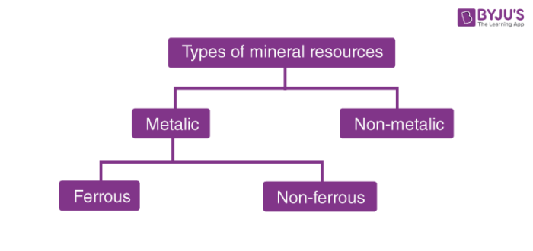
Categories of mineral resources

Slide 9
Characteristics of Metallic Minerals
Metallic Minerals show a metallic shine in their appearance.
The potential source of the metal that can be got through mining.
Contains metals in their chemical composition.
Metallic minerals contain metal in raw form.

Slide 10
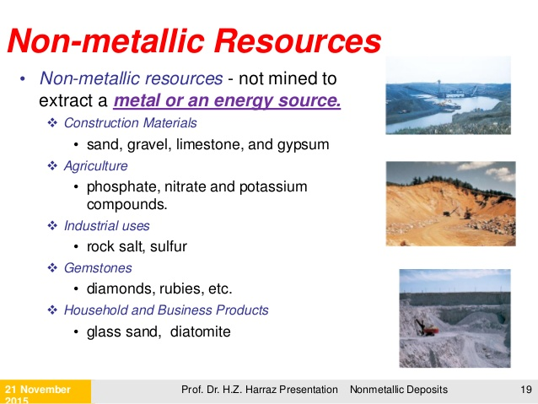

Slide 11
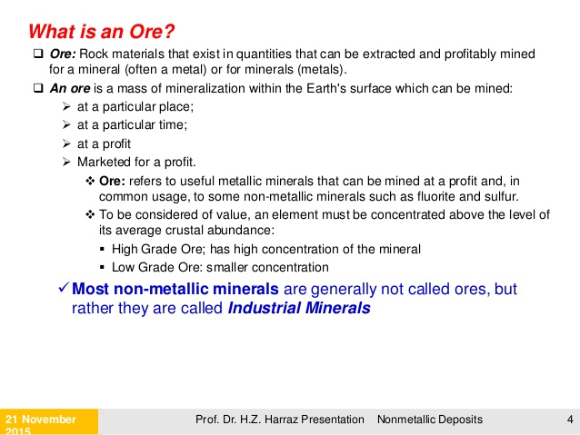

Slide 12
Use of minerals
The use of minerals depends on its properties.
Minerals are used in almost all industries, gold, silver and platinum are used in jewelry industry.
Copper is used in the coin industry and for making pipes and wire.
Silicon obtained from quartz is used in the computer industry.
Mineral elements are used to produce different colours such as Barium produces glossy greens, strontium produces red , copper yields blue.

Slide 13
Exploitation of mineral resource
Mining is the major activities performed to extract the valuable minerals.
Mining refers to the process of extracting metals and minerals from the earth. Gold, silver, diamond, iron, coal, and uranium are just a few of the vast array of metals and minerals that are obtained by this process. Mining activities require the clearing of large areas of land.
In fact, mining is the source of all the substances that cannot be obtained by industrial processes or through agriculture.
Mining involves the physical removal of minerals from the crust of Earth. The mineral materials may be used as such or used for extraction of elements.

Slide 14
Methods of Mining
Surface mining is less expensive, safer and involves fewer complications with air, electricity, water and rock handling. However, surface mining has a greater environmental impact than underground mining. Thus, surface mining operations disturb the surface more seriously.

Slide 15
In open pit mines, extraction proceeds by drilling, blasting, loading, transporting and dumping the ore out of the pit. In strip mining of coal, clay, bauxite, tar sands, phosphates, iron ores, etc., overburden is removed and dumped to the rear and the ore is scooped up and loaded into trucks.

Slide 16
Deep mines are extracted using underground minining methods. In most mines, ore extraction and mine development involve drilling and blasting, and removal with mechanical diggers onto underground railway cars or dump trucks that reach the surface through a shaft.
Hydraulic mining uses high-pressure water jets to wash soft sediments down an incline toward some form of concentration plant, where dense mineral grains (such as gold) and soft mineral grains (such as clay/kaolin) are separated.
Solution mining (leaching) involves dissolving the ore (Au, Ag, U, S, NaCl, etc.) with a liquid (water, cyanide, etc.). If the ore is extracted on site with solution mining, it is called in-situ leaching.

Slide 17
Impact of mining on environment
Energy consumption: mining requires huge amount of energy. Energy is consumed in transportation, fuel, smelting and other processes.
Air pollution: Mining has a great effect on the quality of air. For example coal mines release methane which contributes in green house effect.
Water pollution: Mines use a lot of water, though some of the water is reusable. Sulphides-containing minerals negatively impacts groundwater.
Land pollution/ Degradation: Mining can cause physical damage to the landscape creating waste rock piles and open pits. Such disturbances may cause decline of wild life and loss of biodiversity in that area.

